Slide 1
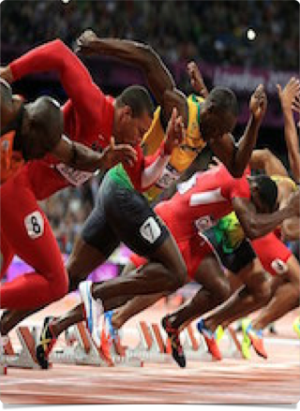

Elite Athletics: is the false start disqualification rule appropriate?
Kevin Brosnan

Slide 2

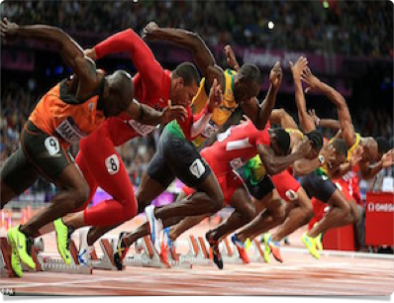

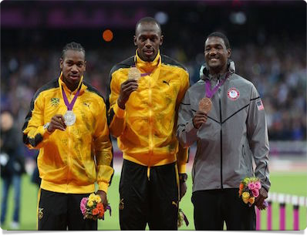

Slide 3
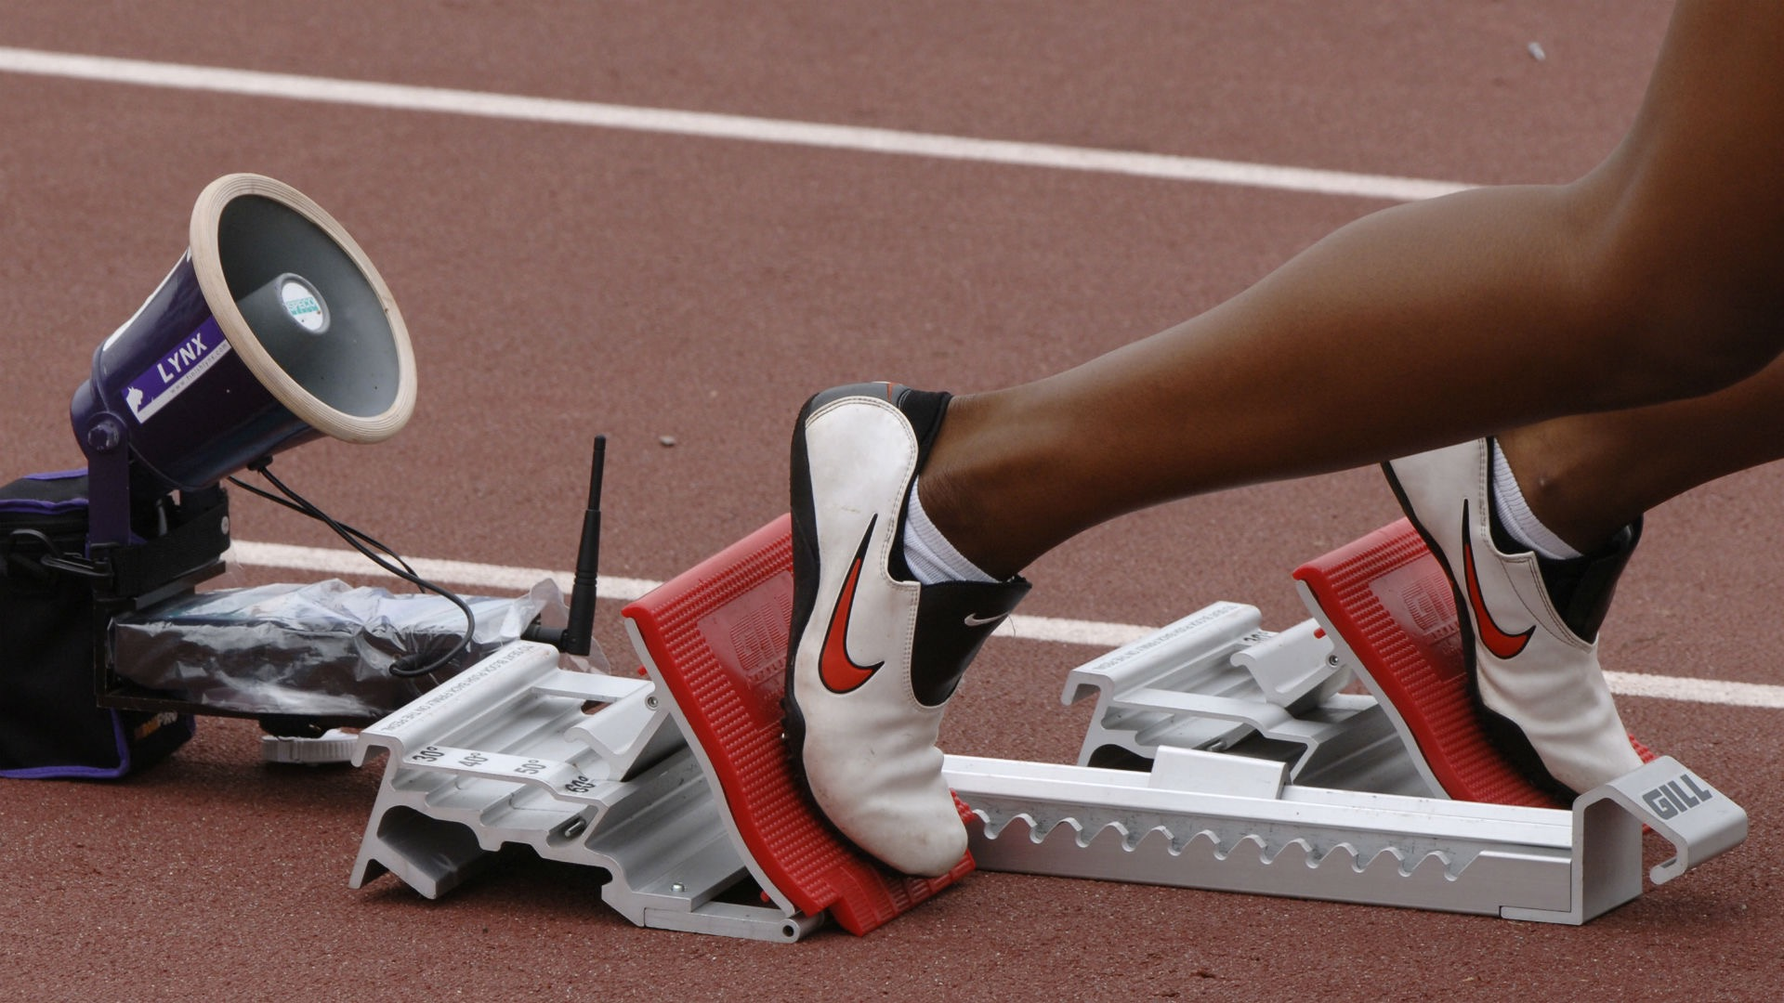
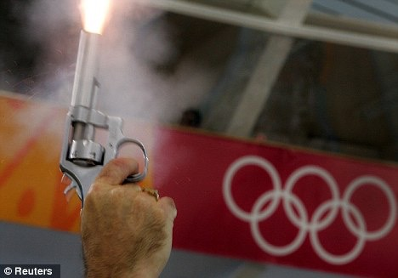

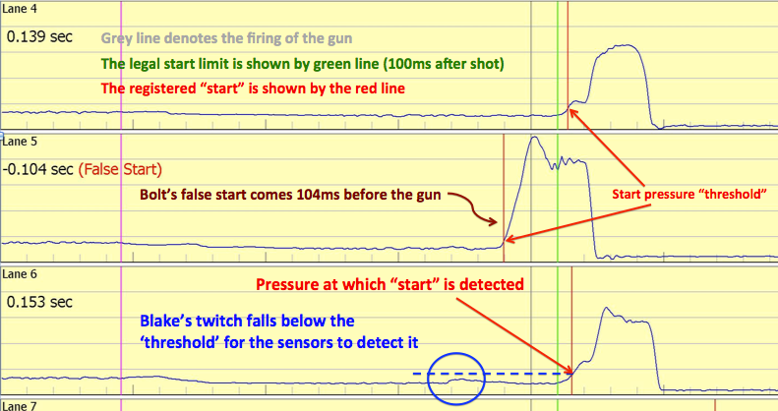

Slide 4






False Start 1: Lane 5
False Start 1: Lane 5
False Start 1: Lane 5
Lane 7 Athlete Disqualified
Lane 7 Athlete Disqualified
Lane 5 Athlete Disqualified
False Start 2: Lane 7
False Start 2: Lane 7
False Start 3: Lane 7
1
2
3
4
5
6
7
8
1998
2004
2010
2016
Individual Warning
Group Warning
Automatic DQ

Slide 5
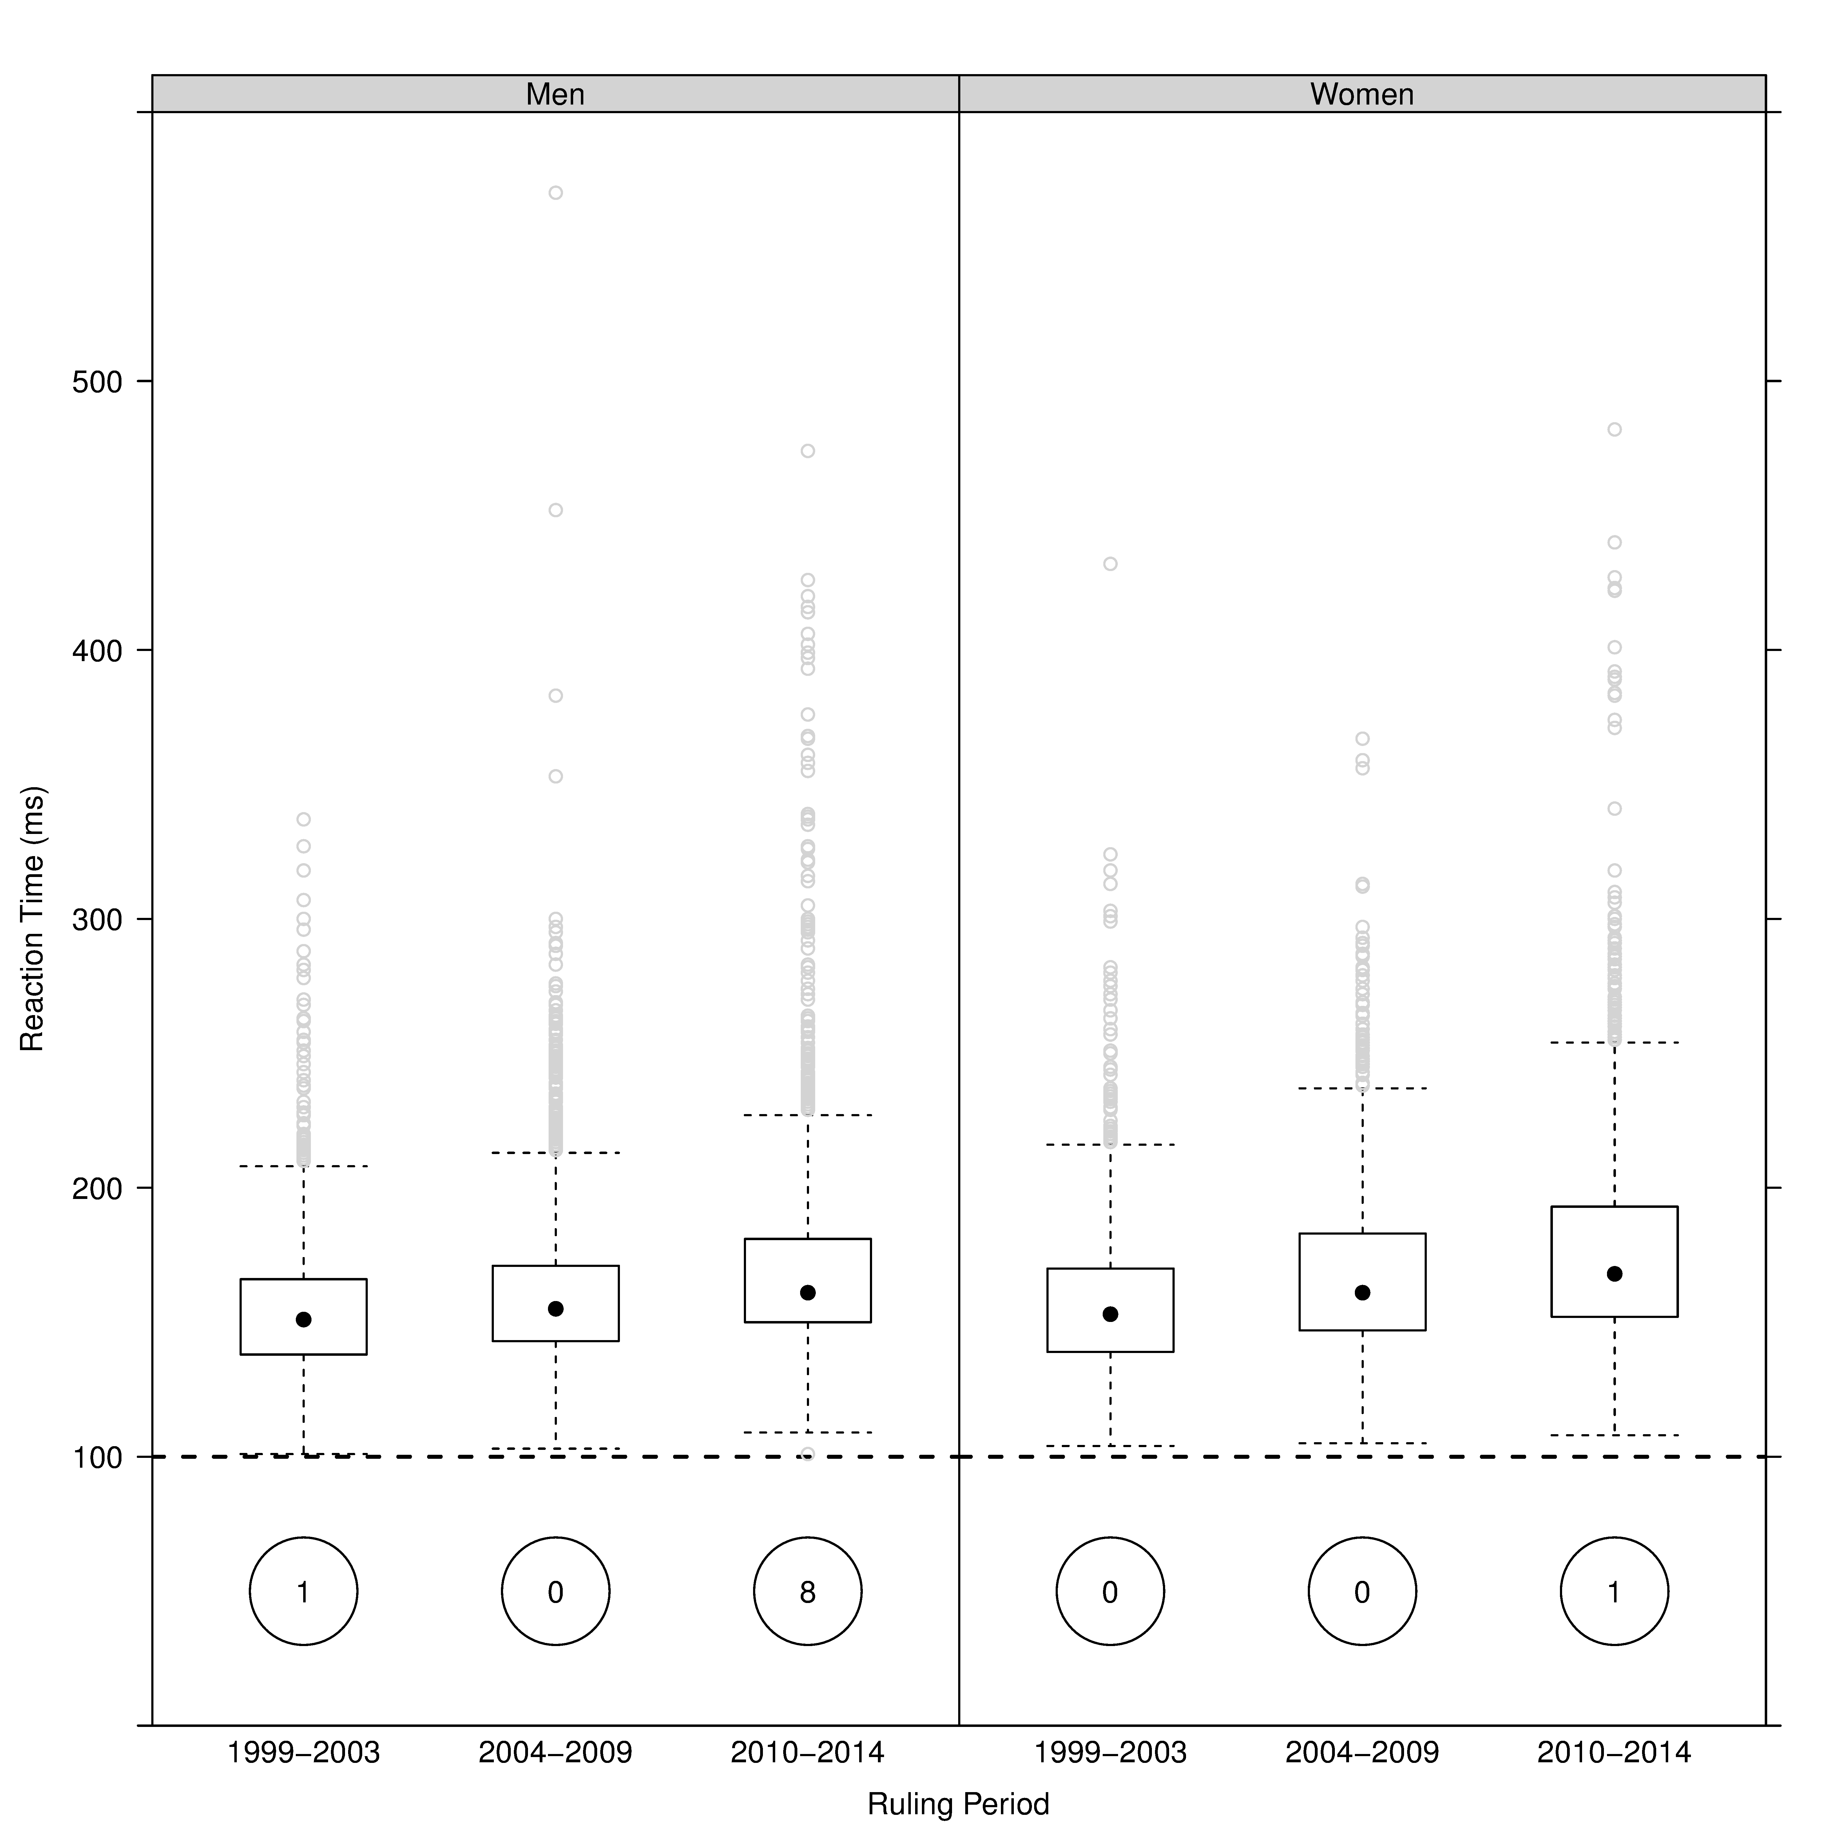
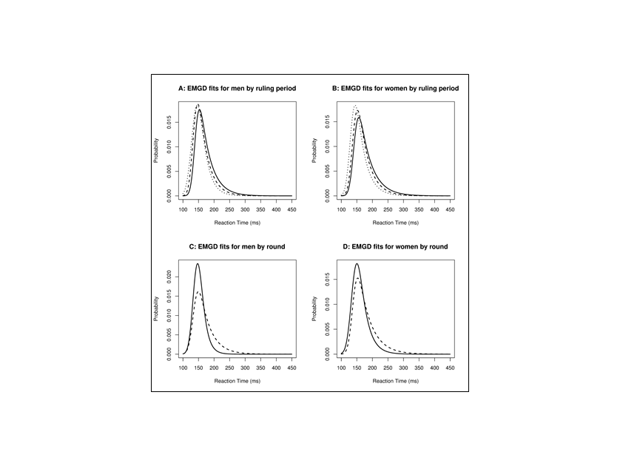
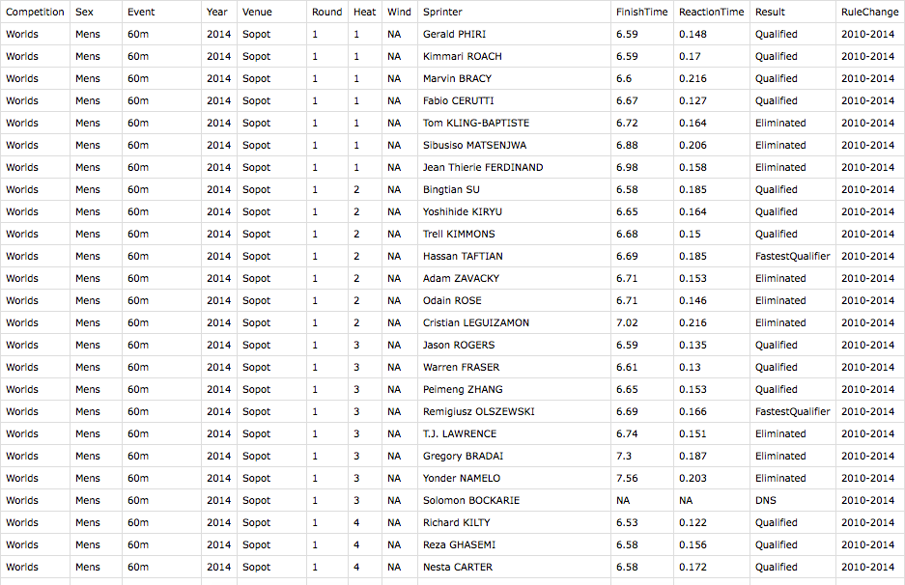

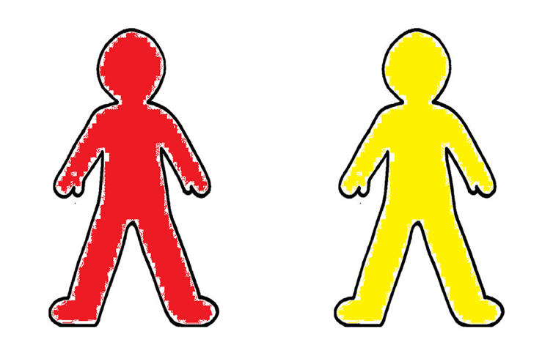
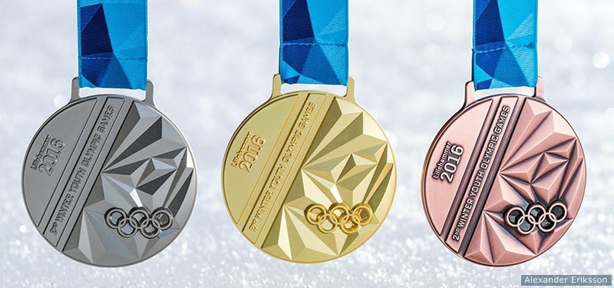
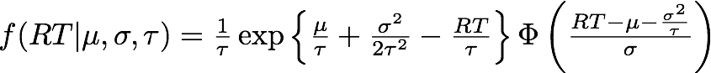
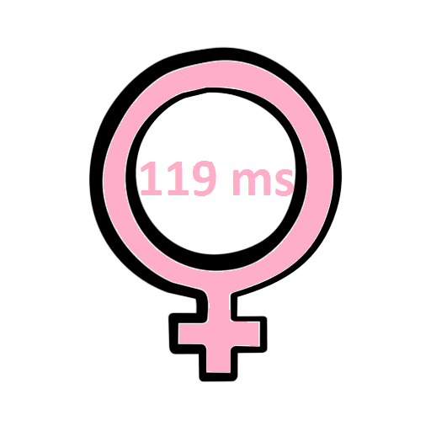
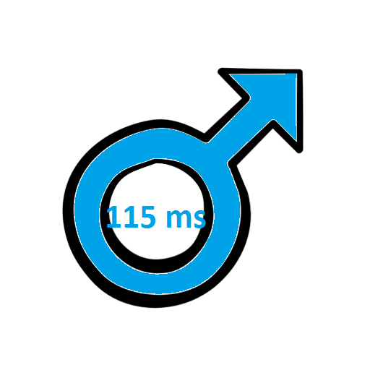
Recommendations
Pretty
Pictures
DATA
Results
Modelling

Slide 6


Prof. Andrew Harrison,
Department of Physical Education and Sports Sciences,
University of Limerick
Dr. Kevin Hayes,
Department of Mathematics and Statistics,
University of Limerick

Slide 7
Thanks for Listening
Questions?

